Slide 1




INFLATION IMPACT ON STOCK MARKET
Uncovering the Market Collapse Point

Slide 2

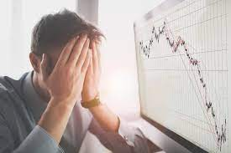
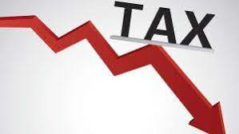

Business Justification:
Inflation is an ever-present force within Finance, capable of big impact on the Economy. The consequences of failing to comprehend the intricate relationship between inflation and the stock market can be devastating.
Crashing of the stock market can have detrimental effects like :
Unemployment on a largescale Loss in investments Reduction in Tax Increase in wealth inequality
And Much more………
These can be avoided by understanding the relation, identifying the point of collapse and taking necessary steps to prevent them. The new information will enable investors to make informed decisions, financial institutions to implement effective risk management strategies, and policymakers to create more resilient economic policies.

Slide 3
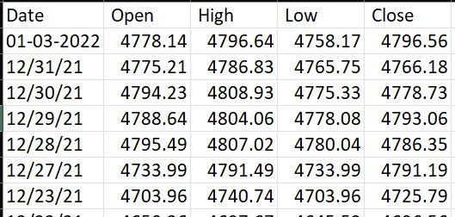
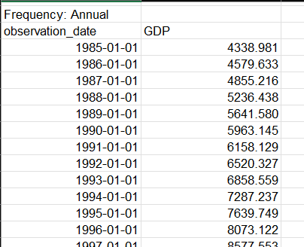
Data Sets:
Data Type: Time Series Data
Historical Stock market dataset: 1985 - 2022
Source : Yahoo finance
Dow jones industrial average
S&P500
S&P500 Healthcare Sector index
S&P500 Financial sector index
Data Type: Time Series Data
Inflation Data set : 1985 – 2022
Source : US Bureau of Labour Statistics
Consumer Price index (CPI)
Example : S&P 500 index Data set
Data Type: Time Series Data
Source : U.S Bureau of Economis Analysis
USA Gross Domestic Product (GDP) per year
Example : USA GDP per year

Slide 4

Anticipated Outcomes:
Hypothesis Testing:
We will conduct hypothesis tests to determine if specific inflation levels significantly influence stock market behavior.
Regression Models:
By using regression models, we will be able to measure the relationship between Inflation rates and Stock market.
Predictive analysis:
We will predict the Stock Prices using the historical data against the Different Inflation rates.

Slide 5

Challenges and Questions
Cleaning the data
Data Integration : Combining multiple datasets
Is the data from 1985 necessary for accurate prediction??

Slide 6
THANK YOU

